Slide 1
Road Signs Identification using a Neural Network
Submitted in the partial fulfillment for the award of the degree of
BACHELOR OF ENGINEERING
IN
ARTIFICIAL INTELLIGENCE AND MACHINE LEARNING
Submitted by:
Debashis Garai (18BCS6054)
Pranay Reddy (18BCS6100)
Chitrang Juneja (18BCS6115)
Utkarsh Gangwar (18BCS3777)
Under the Supervision of:
MS. JYOTI PRUTHI
Department of AIT-CSE
DISCOVER . LEARN . EMPOWER

Slide 2
Outline
Introduction to Project
Problem Formulation
Objectives of the work
Methodology used
Results and Outputs
Conclusion
Future Scope
References

Slide 3
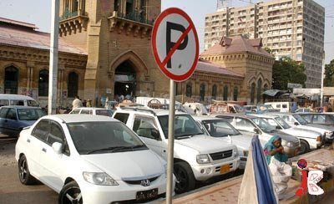
Introduction to Project
Traffic signs in India are like a guide on the road and thus, having good knowledge about them is a must for everyone especially the person driving the vehicle. India ranks first in the number of road accident deaths across the 199 countries and accounts for almost 11% of the accident-related deaths in the World due to ignorance of these signs.
This project basically works on all the traffic signs that a driver comes across in his daily life and the main intention of this project is to identify all those traffic signs using Neural Networks, making it easier for the driver to identify the signs in harsh conditions.

Slide 4
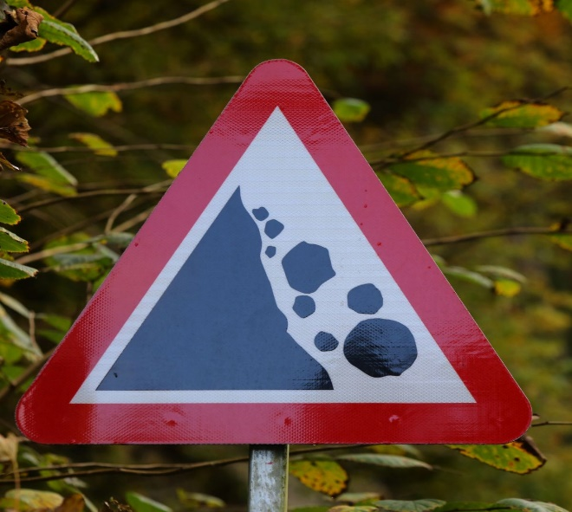
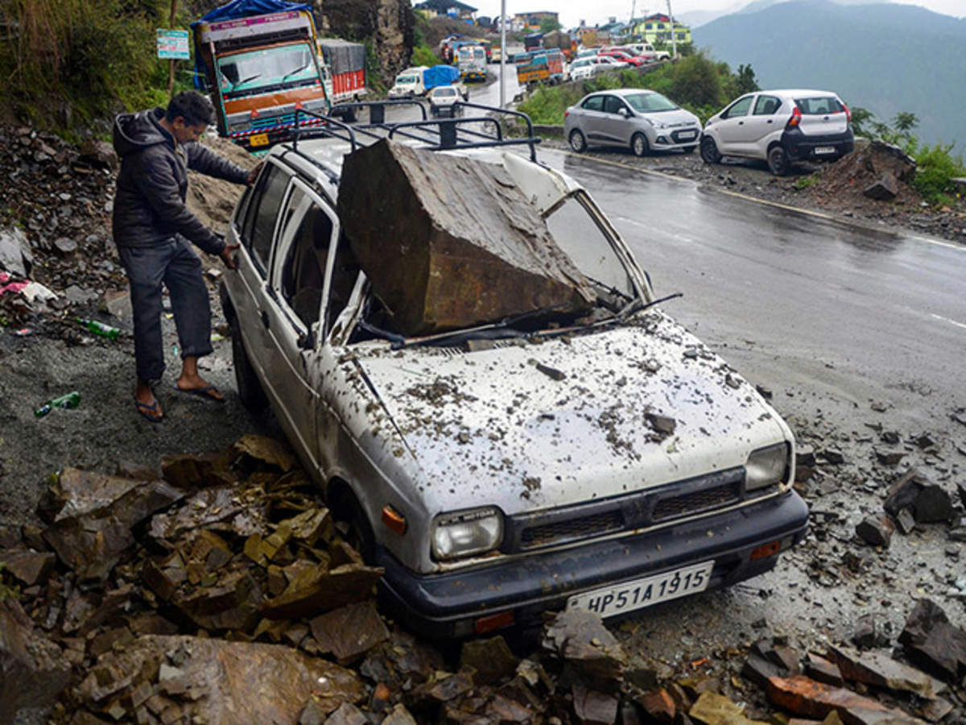
Problem Formulation
Traffic signs and road safety in India are a must know for everyone to make sure they are safe on roads and so are the people around them. Good knowledge and understanding of the road signs in India can reduce the number of accidents that happen on the road. India has one of the highest numbers of road accidents in the world. Under severe weather conditions such as fog and snowy, traffic accidents occur frequently due to distracted driving, inattentiveness, or poor visibility. Moreover, lack of awareness about traffic signs and the casual attitude towards these sign boards, by the fellow citizens of the country, is one of the major causes for road fatalities.

Slide 5
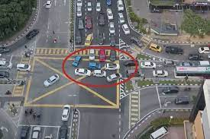
People casually ignore or don’t recognize the traffic signs. To decrease the risk of accidents and improve the driving experience of drivers, road signs identification system will be developed and will play an important role in autonomous driving and road network maintenance.
It will be designed and deployed in vehicles to avoid one of the prime reasons which lead to such fatalities. Upon deployment, this project will alert & inform the driver of the vehicle about the traffic signs coming ahead. This smart system will not only support the casual drivers but also will provide ease of life for people of any age group.

Slide 6

Objectives of the Work
The major goal is to use Convolutional neural networks to classify, recognize, and identify the traffic signs. Convolutional neural networks are a part of deep learning and extensively used in image recognition and once the model is ready, we will present the outcomes in a python-based Graphical user interface (GUI) with the help of tkinter library.
In order to achieve this objective, we have to overcome some mini objectives which are stated as follows:
Firstly, loading the dataset of Traffic Sign and then explore and summarize each of the dataset to uniquely visualize them.
Then we will build the model for which we will use sequential model from keras library. Then we will add the layers to make convolutional neural network.

Slide 7

Up next, to design the training and the testing models and to test the model’s performance with the new images.
According to the model’s performance, we have to find ways to maximize the accuracy of the model.
Then, to design a user-friendly GUI with the help of tkinter library which accepts the model and produces required results.
Finally, will test the GUI in other situations.

Slide 8
Methodology used
The whole methodology for our project can be described in 6 steps:
Data Collection and Preparation: Given the problem you want to solve, you will have to investigate and obtain data that you will use to feed your machine. The quality and quantity of information you get are very important since it will directly impact how well or badly your model will work. In our project we already have collected the humongous image data. After the data collection part, we have to visualize our data and check if there are correlations between the different characteristics that we obtained.
Choose the model: There are several models by which this project can be approached, but as we have used deep learning instead of machine learning, we are proceeding with CNN. We have selected Convolutional Neural Networks for our model as it deals with image processing and our road signs identification system falls under this category.

Slide 9
Training the model: We need to train the datasets to run smoothly and see an incremental improvement in the prediction rate. We have to initialize the model weights randomly as the weights are the values that multiply or affect the relationships between the inputs and outputs, which will be automatically adjusted by the selected algorithm the more we train them.
Evaluation: We have to check the machine created against our evaluation data set that contains inputs that the model does not know and verify the precision of the already trained model. If the accuracy is less than or equal to 50%, that model will not be useful since it would be like tossing a coin to make decisions.
Parameter Tuning: If during the model evaluation the accuracy is not up to the mark as expected or is less than the bare minimum, then there is a possibility of underfitting or overfitting, which will be solved by training the model with the new set of parameters. We can increase the number of epochs.
Prediction on interface: One is now ready to use our Machine Learning model for inferring results in real-life scenarios which in our case is road signs identification system and its visualization using the GUI.

Slide 10
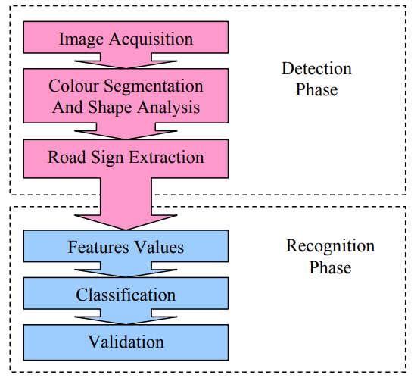
Fig. Depiction of road signs detection & recognition phase

Slide 11
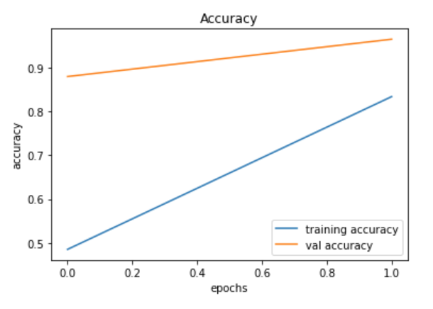
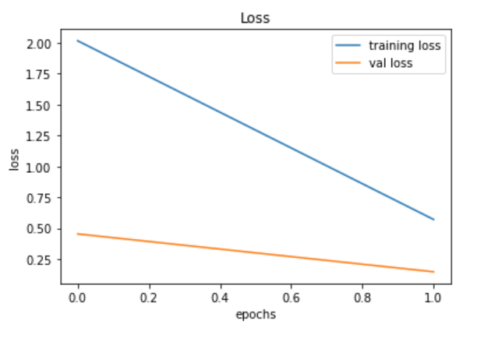
Results and Outputs

Slide 12
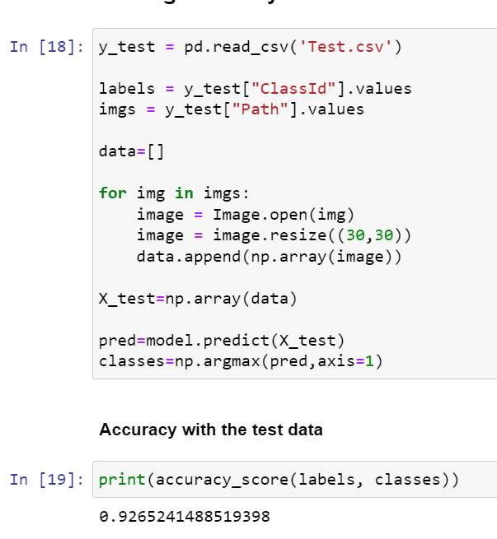
Results and Outputs

Slide 13
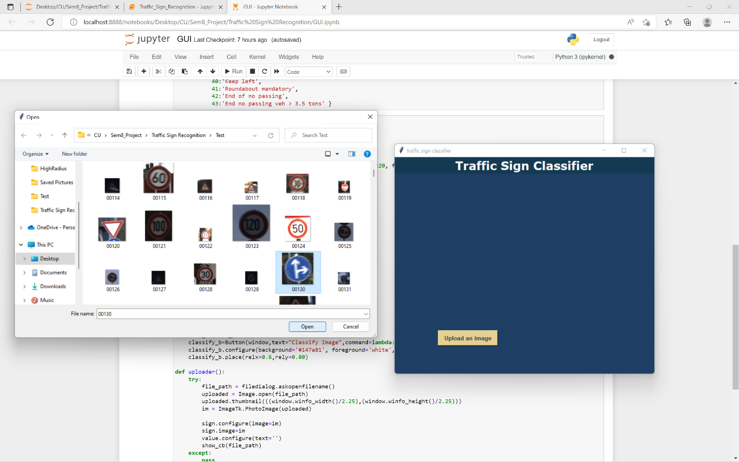
Results and Outputs

Slide 14
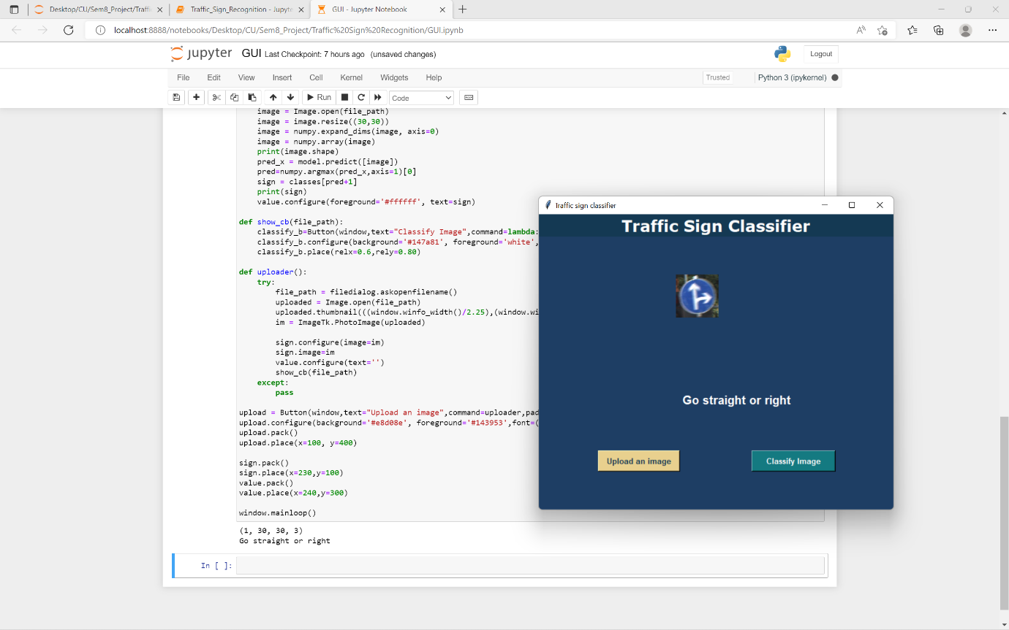
Results and Outputs

Slide 15
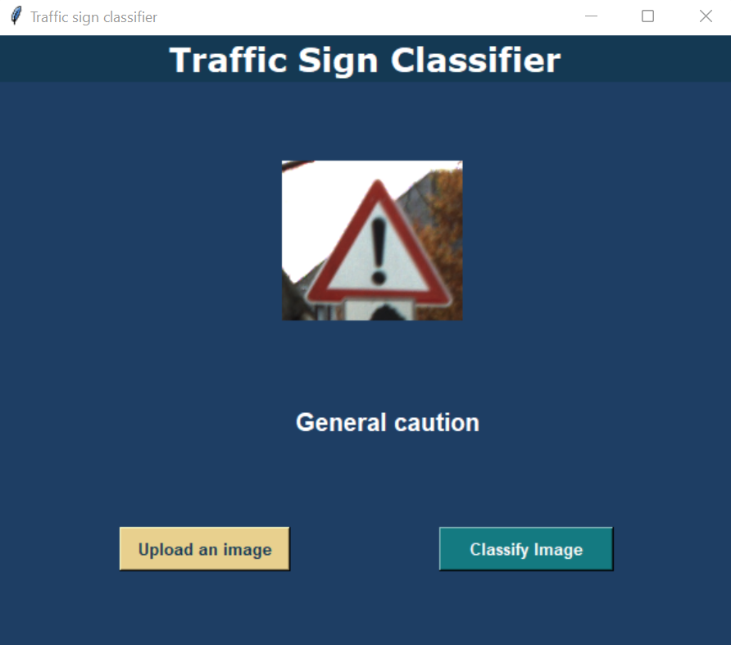
Results and Outputs

Slide 16
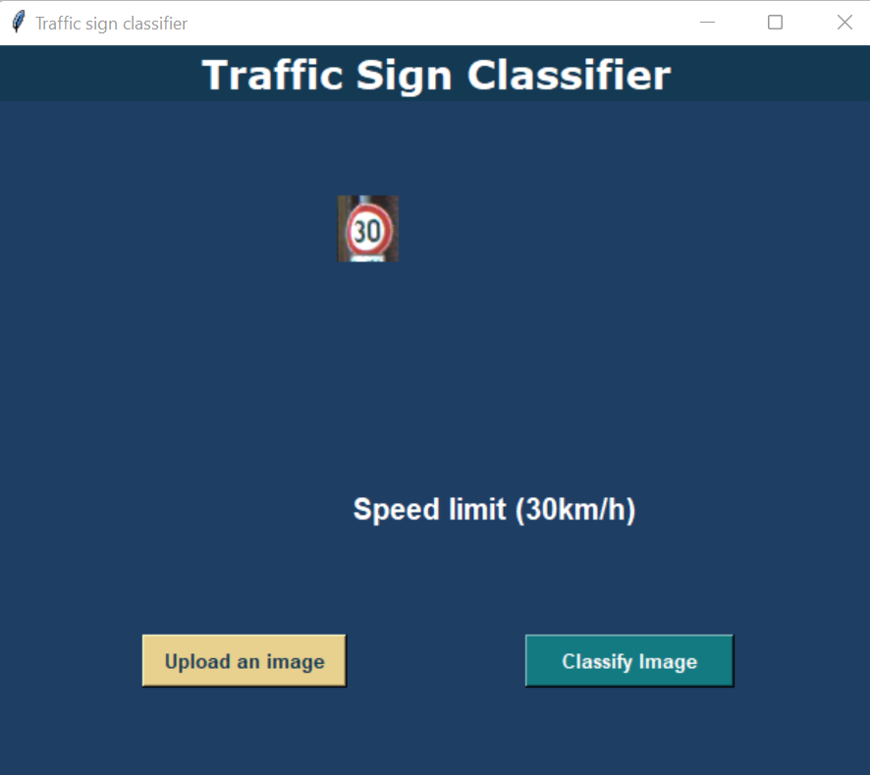
Results and Outputs

Slide 17
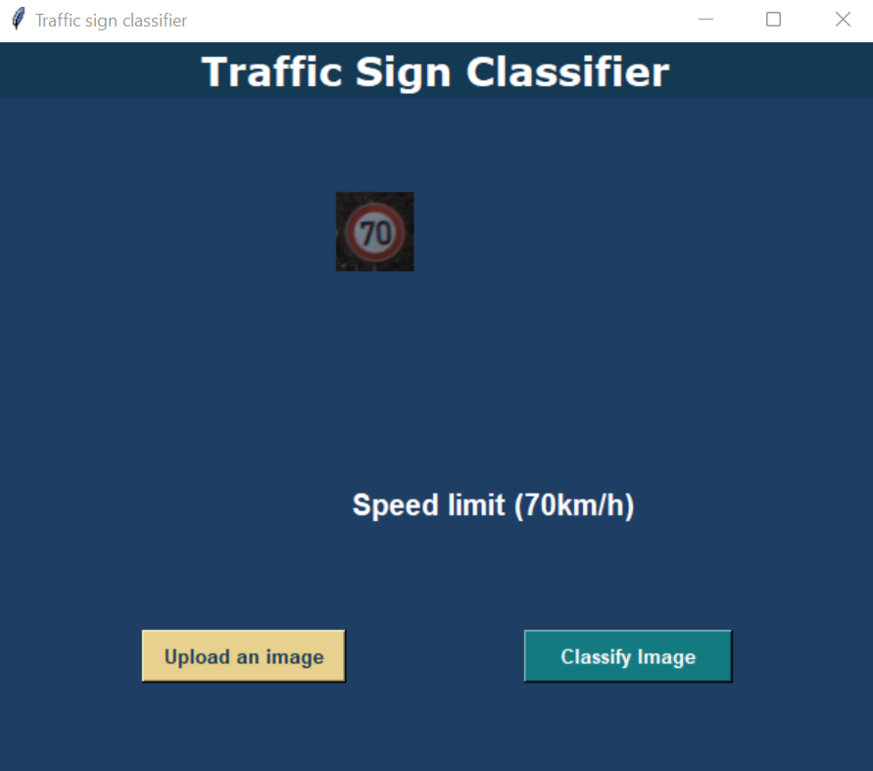
Results and Outputs

Slide 18
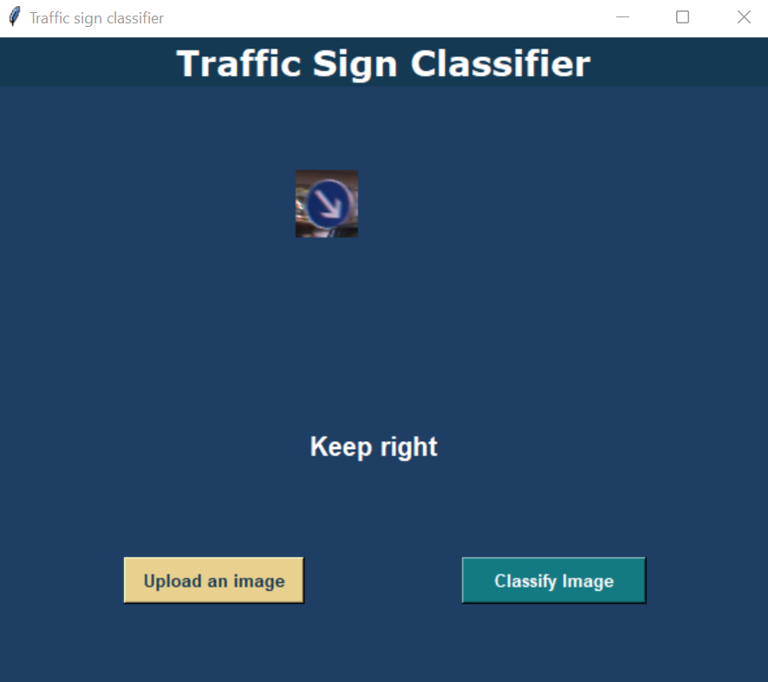
Results and Outputs

Slide 19
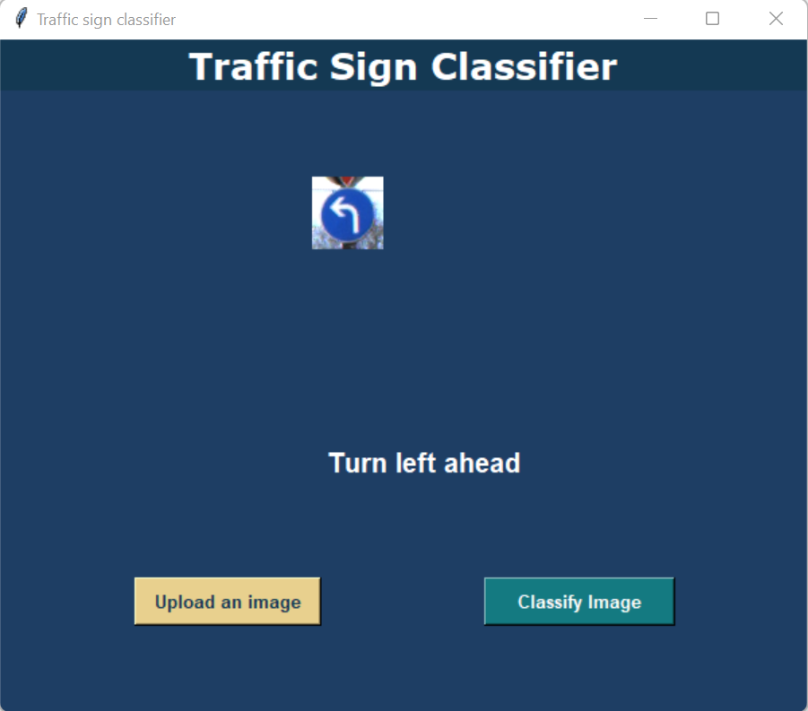
Results and Outputs

Slide 20
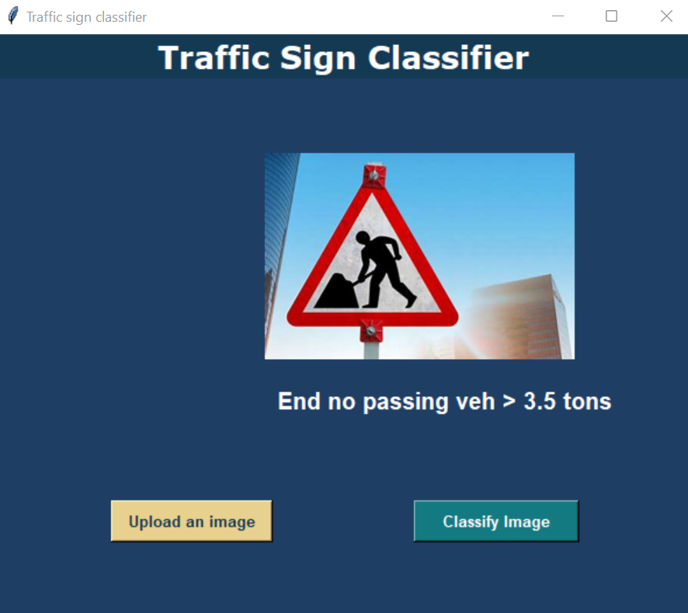
Results and Outputs

Slide 21

Conclusion
This project report designed, deployed, and tested a rudimentary approach to a road and traffic sign identification system that can help create a road sign inventory. This system solved a number of computer vision and pattern recognition problems. Road signs can be retrieved from still photos of complex settings that are subject to changing conditions. The use of traffic sign color and shape data has solved the problem of traffic sign recognition for the purpose of road sign inventory. A new set of algorithms has been designed and tested in a number of settings, and the results have been solid and consistent. The success of the proposed system opens up new avenues for future research.

Slide 22
Future Scope
For now we have the model ready with us to be deployed in a software. The prime scope is to use the technology and hardware available to deploy our model physically in vehicles.
A challenge we encountered was to assess the noisy and grainy pictures of road signs, which definitely could be worked upon in future as the field image processing is constantly evolving.
In the future, the recognition phase can be sped up using dimension reduction of feature vectors.
Upon deployment the purpose of road signs which is to promote road safety and efficiency by providing for the orderly movement of all road users on all roads in both urban and non-urban areas, can be fulfilled efficiently.

Slide 23
References
Aparna A. Dalve , Sankirti S. Shiravale, “A Survey on Real Time Text Detection and Recognition from Traffic Panels, ”in Proc. IJRASET, vol. 3, Dec, 2015.
Emre Ulay, “Color and Shape Based Traffic Sign Detection”, Thesis submitted to the Graduate School of Natural and Applied Sciences of Middle East Technical University, November 2008.
Fatin Zaklouta and Bogdan Stanciulescu, ‘Robotics and Autonomous Systems, Real-time traffic recognization in three stages’, Robotics and Autonomous Systems 62(2014) 16-24.
P.G. Jimenez, S. Lafuente-Arroyo, H. Gomez-Moreno, F. Lopez-Ferreras, S. MaldonadoBascon, ‘Traffic sign shape classification evaluation’, part II, FFT applied to the signature of blobs, in Intelligent Vehicles Symposium, 2005, Proceedings, IEEE, IEEE, 2005, pp. 607– 612.
Y. Aoyagi and T. Asakura, “A study on traffic sign recognition in scene image using genetic algorithms and neural networks,” in Proc. IEEE IECON 22nd Int. Industrial Electronics, Control, and Instrumentation Conf., vol. 3, 1996, pp. 1838–1843.
H. Bay, T. Tuytelaars, and L. van Gool, “Surf: Speeded up robust features,” Computer Vision and Image Understanding, vol. 110, no. 3, pp. 346–359, 2008

